Slide 1

AMERICA
Advanced Methane Emission and Regolith In-situ Composition Analysis
Steven Beninati, Aidan Clements, Johnathan Corbin, Matthew Dromgoole, Vish Gopalakrishnan, Kevin Iott, Sierra Koch, Jasmina Muftic, Will Parker, Vincent Putrino, Daria Stifel

Slide 2
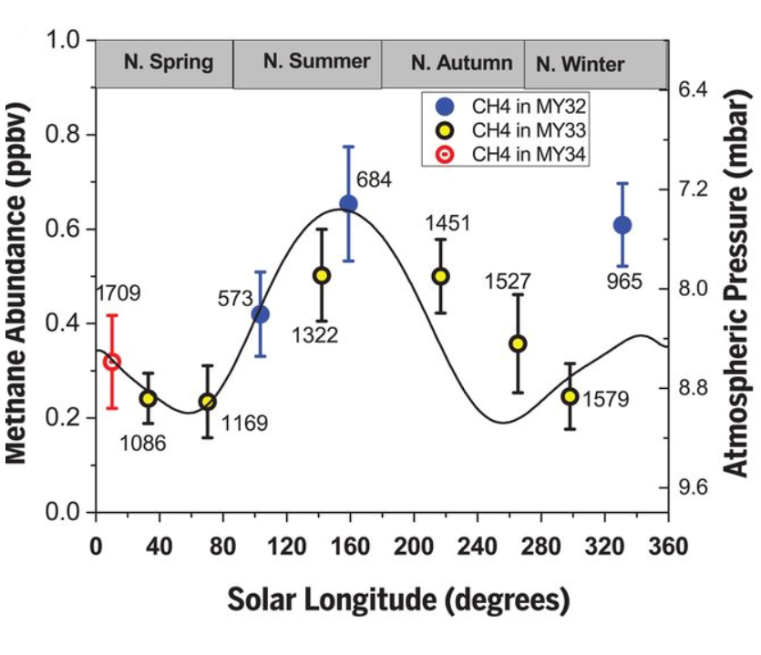
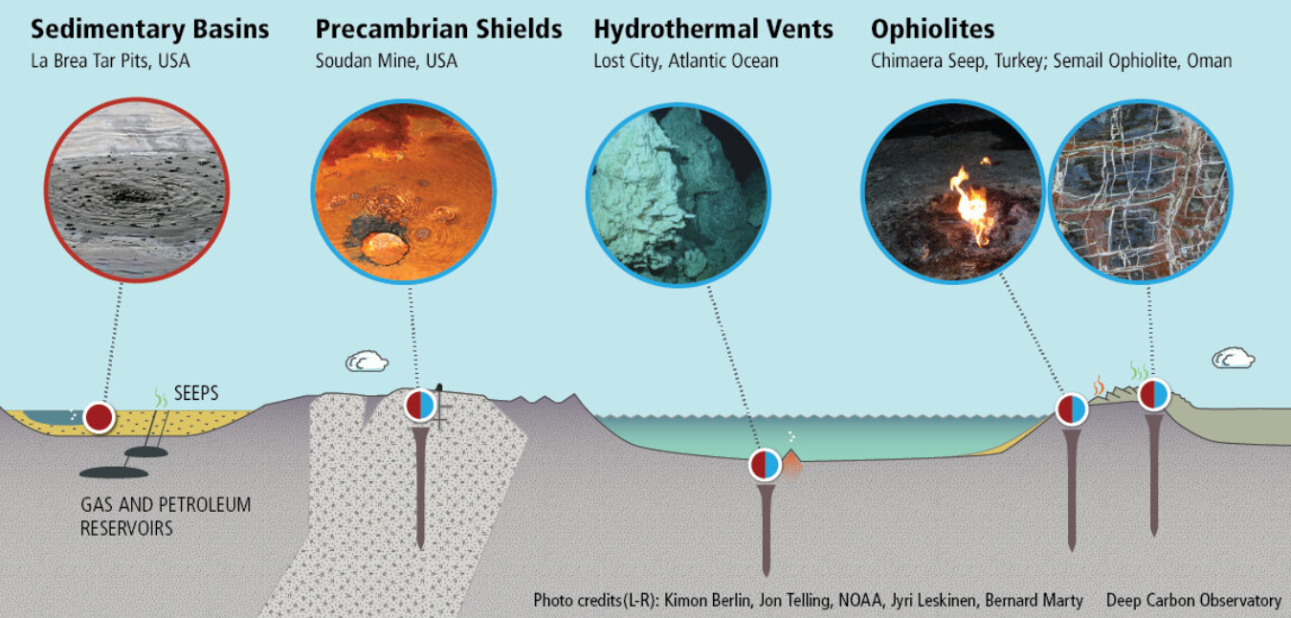
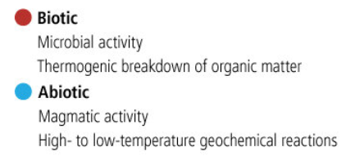
Science Overview - Methane
Methane (CH₄) - organic compound common in Earth’s atmosphere
Biotic, geological
Seasonal variation 0.2-0.7 ppbv [1]
Sporadic spikes recorded up to 21 ppbv [3]
~300 year atmospheric lifetime (UV photolysis) [2]
Is Mars really geologically and biologically dead?
Regular seasonal atmospheric methane variation [1]
Terrestrial Methane Sources [4]
WP
Notes:
Will

Slide 3
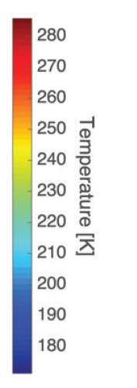
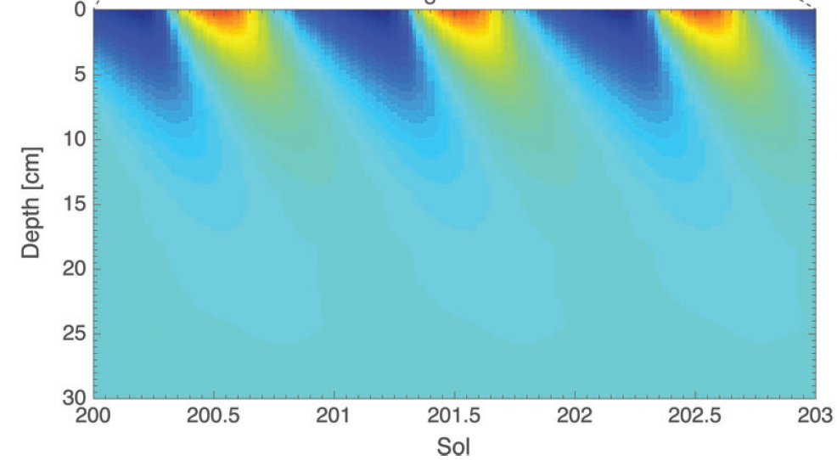
Science Overview - Methane Theories
CH₄
Regolith Adsorption of Methane [5]:
Adsorbs when dry, releases when wet
Methane spikes only occur when surface relative humidity above 60%
Calcium Perchlorate in regolith deliquesces to form liquid solutions
Seasonal temperature and humidity flux penetrate 5-15 cm
(Cyclic Source/Sink)
Ca(ClO₄)₂
regolith
Adsorption
regolith
Regolith temperature penetration [5]
Release
WP
Notes:
Will

Slide 4
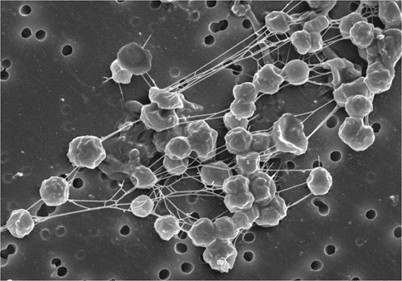
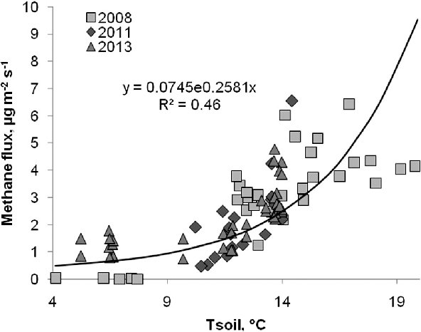
Science Overview - Methane Theories
Extant Microorganisms:
Also dependent on seasonal deliquescence
Methanogens - CH₄ producing archaean microbe
Utilize H₂ and CO₂ as only source of energy and produce methane [5]
Convert organic matter to methane in liquid solution
CH₄ emission varies by soil temperature
(Cyclic Source/Sink)
Methanogens [6]
Terrestrial methane release by soil temperature [7]
WP
Notes:
Will

Slide 5
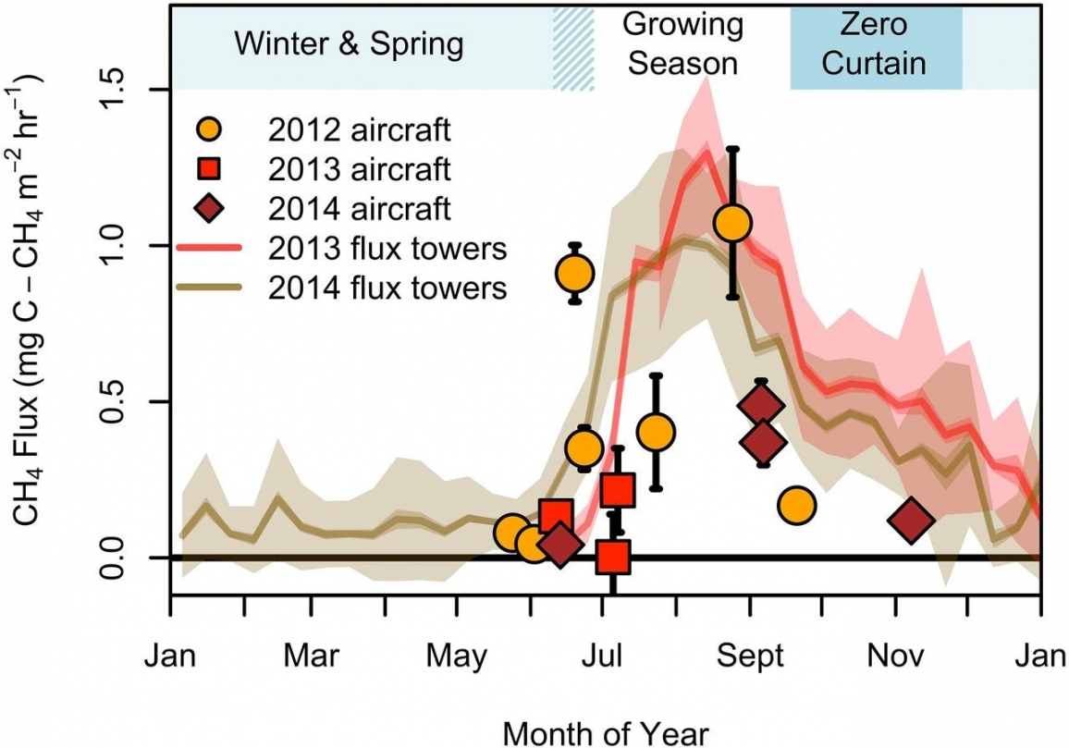
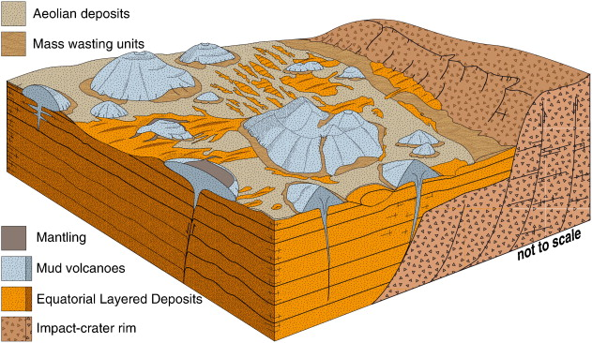
Science Overview - Methane Theories
Deep Subsurface Aquifers (Sporadic) [5]:
“New” methane
Gas-water-rock chemistry or microbial origin
Estimated 5 km depth
Sealed by ice layer
Geological processes
Arctic tundra is major terrestrial source of CH₄
(Local emission of new methane)
Arctic tundra methane flux [8]
Martian mud volcanoes [9]
WP
Notes:
Will

Slide 6
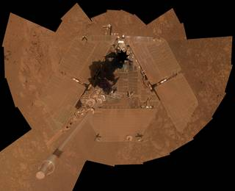
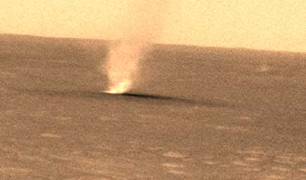
Science Overview - Dust storms
Serious problem for solar cells, spacecraft, and space suits
Unknown processes relating to lifting dust from surface into atmosphere
Desired information:
Charge on individual grains, electric fields generated in dust storms & how these impact dust storm propagation.
Spirit with solar panels covered in dust [10]
A Martian “dust devil” [11]
WP
Notes:
Will

Slide 7
Fundamental Questions
Is the source of martian methane biotic or abiotic?
How do we explain both seasonal and sporadic methane releases?
How do martian dust properties affect storm propagation?
WP,VG,AC,DS, SK, SB,VP,KI,JC,JM,MD
Notes:
Will

Slide 8
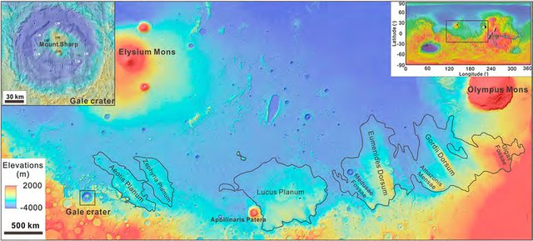
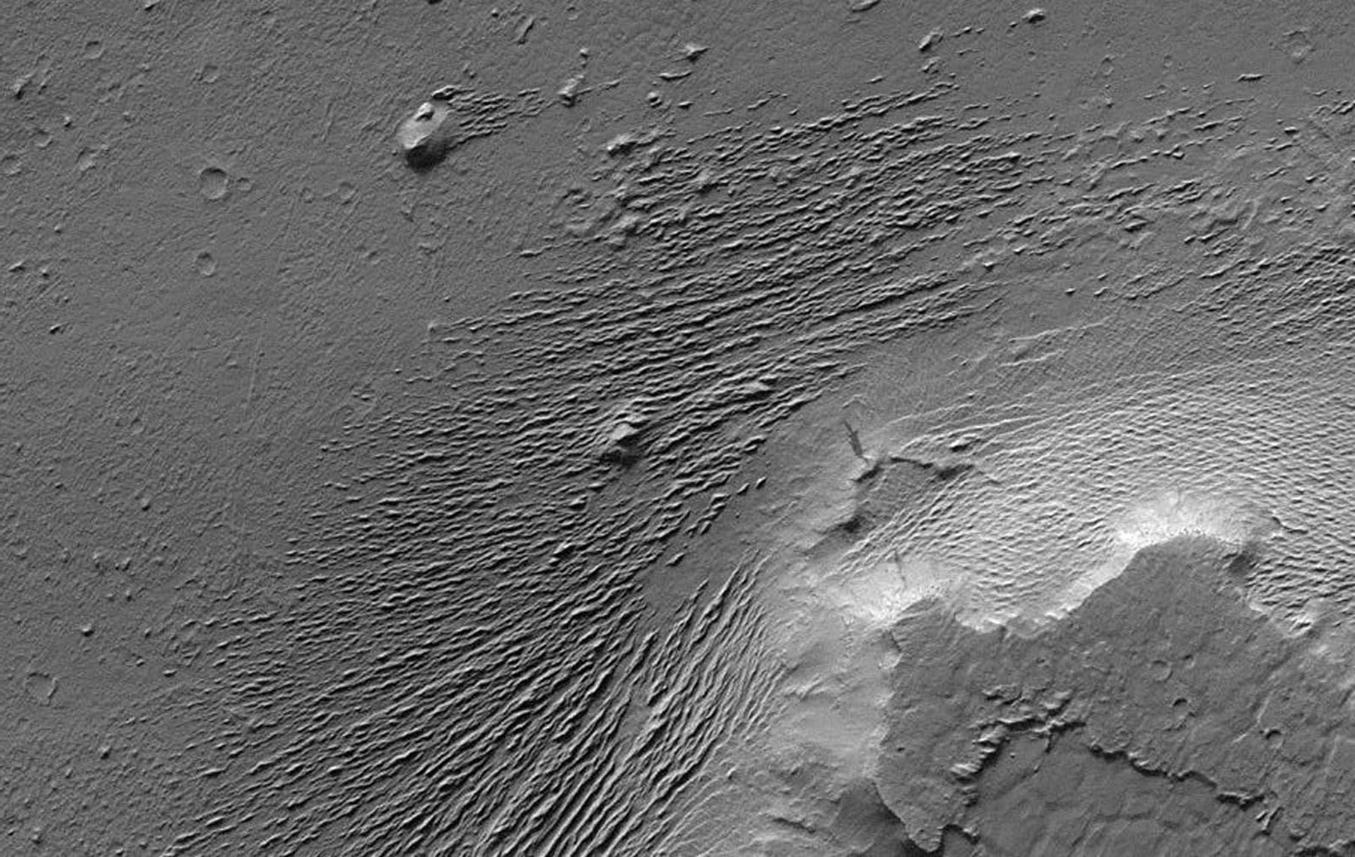
Landing Site Selection
Medusae Fossae Formation (MFF)
3.2° S, 163 ° W
Geologically active region [2]
Layer of shallow subsurface permafrost [2]
Mars’ largest source of dust [13]
Level terrain
Few impact craters
MFF position relative to other well-known martian landmarks [12]
Credit: JPL/NASA
WP, SK
Notes:
Will

Slide 9
Needs, Goals, & Objectives
NEED: Understand the processes and history of the climate and geology on Mars.
GOAL I: Investigate the biotic or abiotic nature of the processes that govern methane variations in the lower Martian atmosphere.
OBJECTIVES:
Characterize methane prevalence and profile atmospheric conditions (humidity, wind speed, pressure, temperature) over time at the surface.
Measure subsurface methane content, water content, and temperature over time.
Visually inspect landscape for signs of processes related to methane release
WP,VG,AC,DS,SB,VP,KI,JC,JM,MD
Notes:
Daria

Slide 10
Needs, Goals, & Objectives
GOAL II: Discover the properties of martian dust and how it relates to geological formations and climate.
OBJECTIVES:
Measure physical and chemical composition of surface regolith at landing location.
Determine physical and electrostatic properties (charge on individual grains, electrical/thermal conductivity) of dust.
Visual inspection of geological formations and samples near landing site.
WP,VG,AC,DS,SB,VP,KI,JC,JM,MD
Notes:
Daria

Slide 11
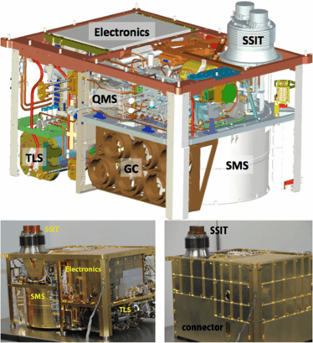
Proposed Instrumentation: Goal I
Methane Observation: Sample Analysis at Mars (SAM)
Tunable Laser Spectrometer (TLS)
Quadrupole Mass Spectrometer (QMS)
Gas Chromatograph (GC)
Ambient Conditions: Environmental Monitoring Station (EMS)
BarocapⓇ and ThermocapⓇ sensors
Sample Acquisition & Manipulation: Robotic Arm
Solid sample collections
Layout of SAM [14]
DS
Notes:
Daria

Slide 12
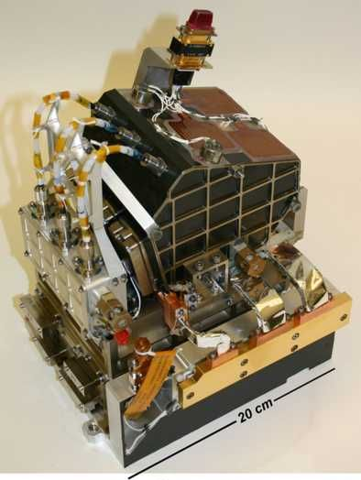
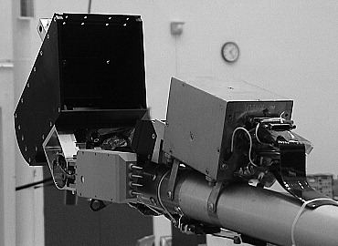
Proposed Instrumentation: Goal II
Martian Dust Composition: Chemistry Camera (ChemCam) & Remote Micro-Imager (RMI)
Laser Induced Breakdown Spectroscopy (LIBS)
Martian Dust Properties: Thermal and Electrical Conductivity Probe (TECP) & Modified Lunar Dust Experiment (M-LDEX)
Thermal & Electrical Conductivity
Dust charge
Regolith temperature
Geological Observation: Mast Camera Z & Microscopic Imager
Visual observation of surroundings
Regolith grain size
ChemCam body unit [15]
TECP mounted on Robotic Arm [16]
DS, SK
Notes:
Daria

Slide 13
Baseline and Threshold Mission
 | Baseline Mission | Threshold Mission
Mission Planning Phase | 0.2 ppbv - 60 ppbv [17] CH₄ Isotope Detection Higher resolution images | 5 ppbv - 30 ppbv [18] No CH₄ isotope detection Lower resolution images
Science Phase |  | :
SAM: | 1 measurement/sol | 4 measurements/week
Temperature and Pressure | 5 min./hour | 5 min. / 2 hours
MastCam & MI | 5 images/week | 3 images/week
TECP | 75 min./sol | 45 min./sol
SB, DS
Notes:
Daria
Isotope detection helps to determine if methane is biotic/abiotic

Slide 14
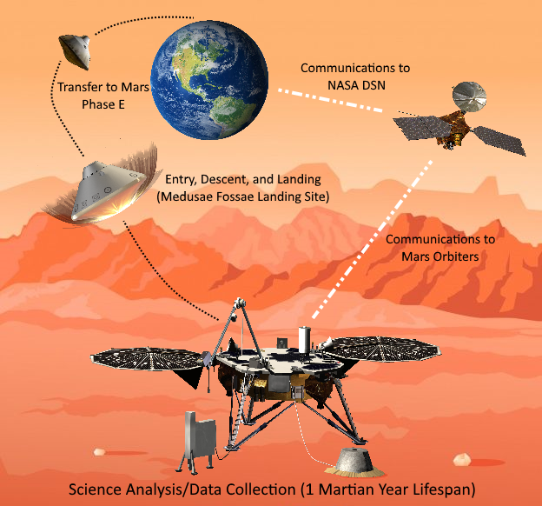
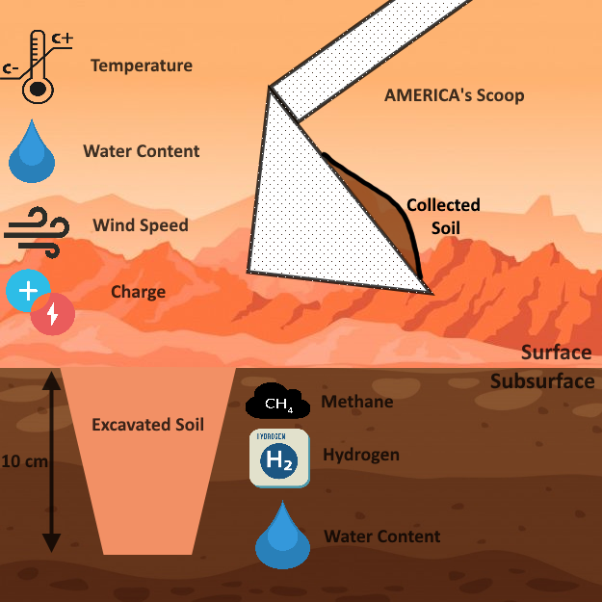
CONOPS
JC, VG, VP, AC
Notes:
Daria

Slide 15
Mission Implementation
Notes:
Vince

Slide 16
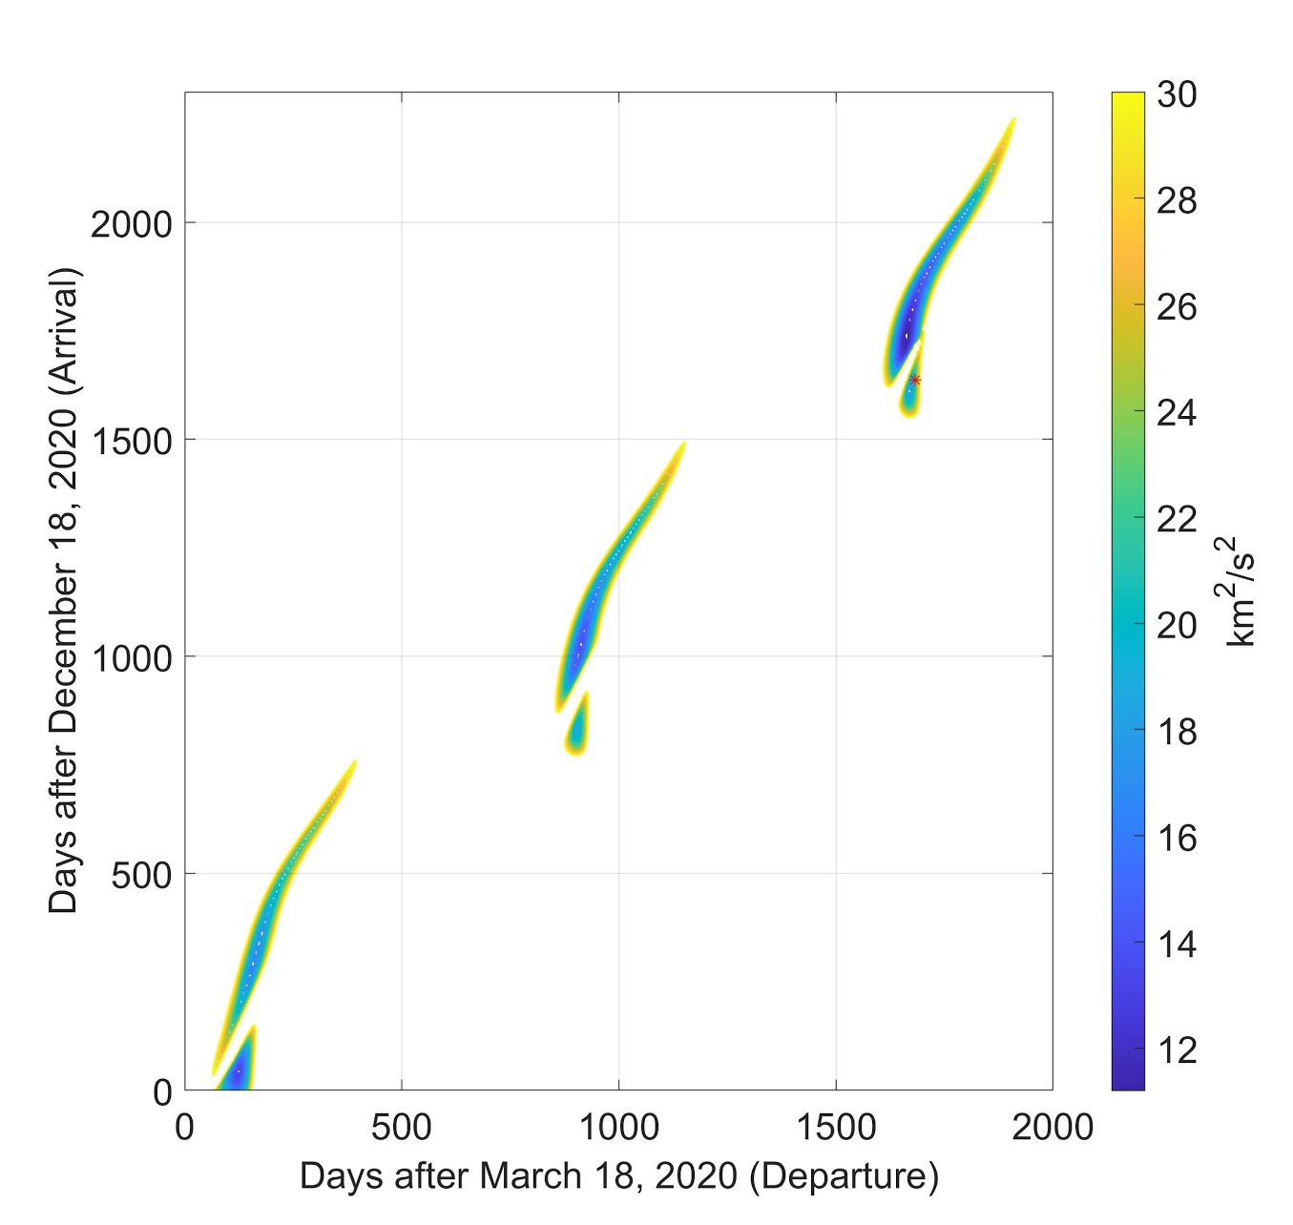
Astrodynamics - Launch Windows
Launch by September 20, 2025
3 possible launch windows
Figure shows dates of the launch windows for a C3 < 30
3 opportunities for launch occur in the following years:
2020
2022
2024
Our focus is on the 2024 window to allow for proper vehicle design and development
Departure C3 Plots
JC

Slide 17
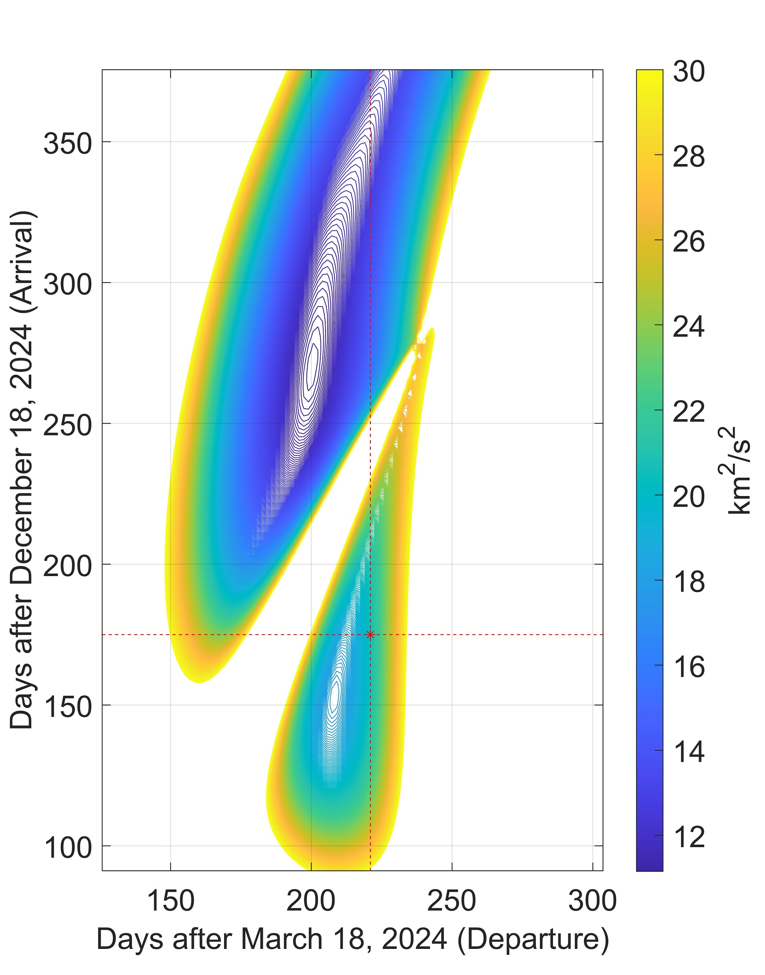
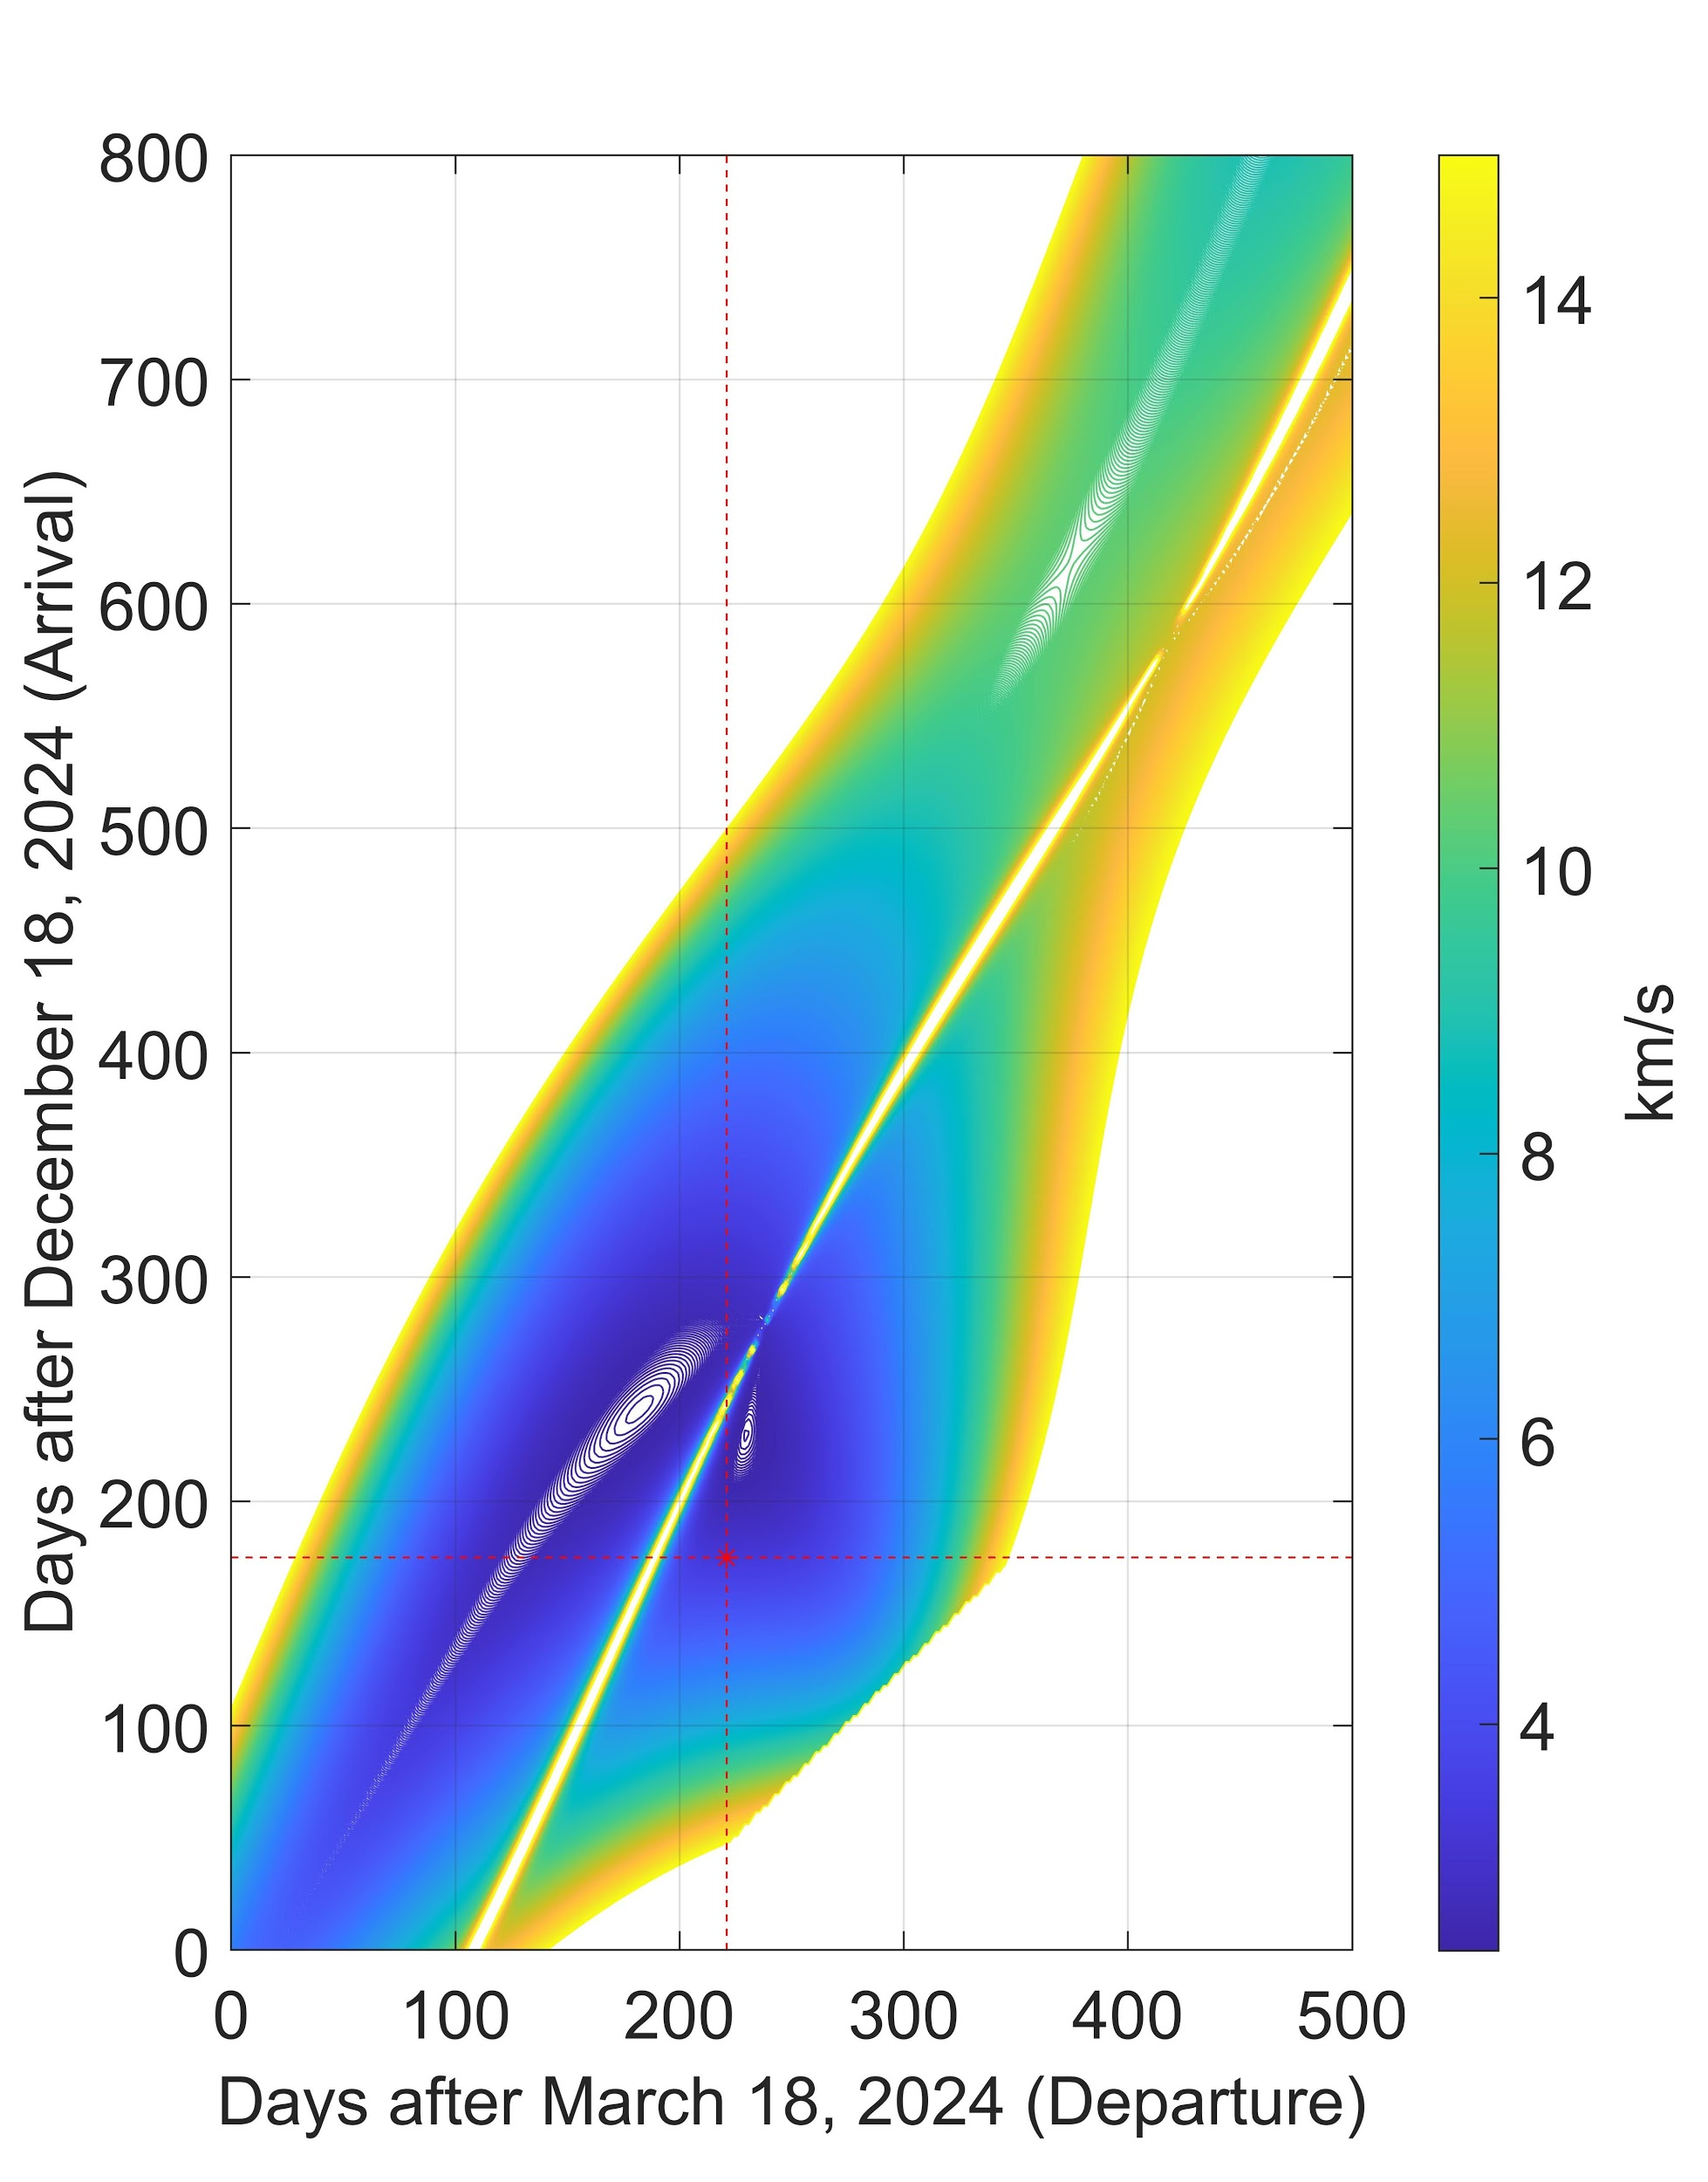
Astrodynamics - 2024 Launch Window
Launch Date:
October 5, 2024
Arrival Date:
June 11, 2025
Duration:
229 days
Transfer type:
Type 1
Smaller time spent in space
Consistent communications
C3 ≅ 20.5 km²/s²
V∞ ≅ 3.29 km/s
C3 Contours
V∞ Contours
JC

Slide 18
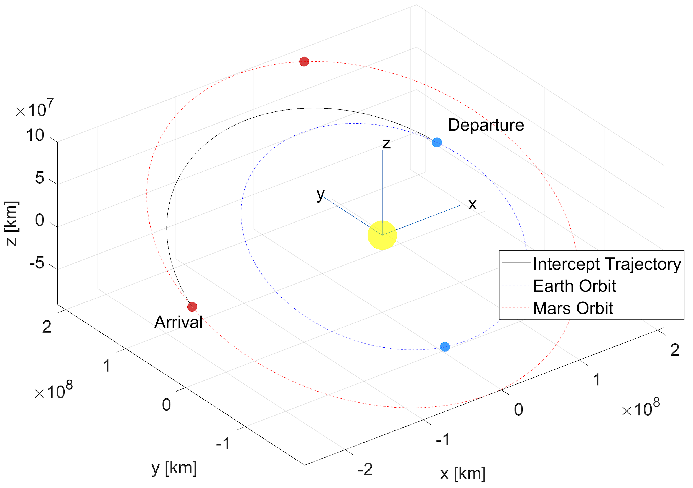
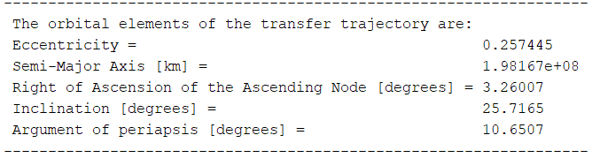
Astrodynamics - Transfer Orbit
Shown to the right in a J2000 Sun-Centered reference frame.
JC

Slide 19
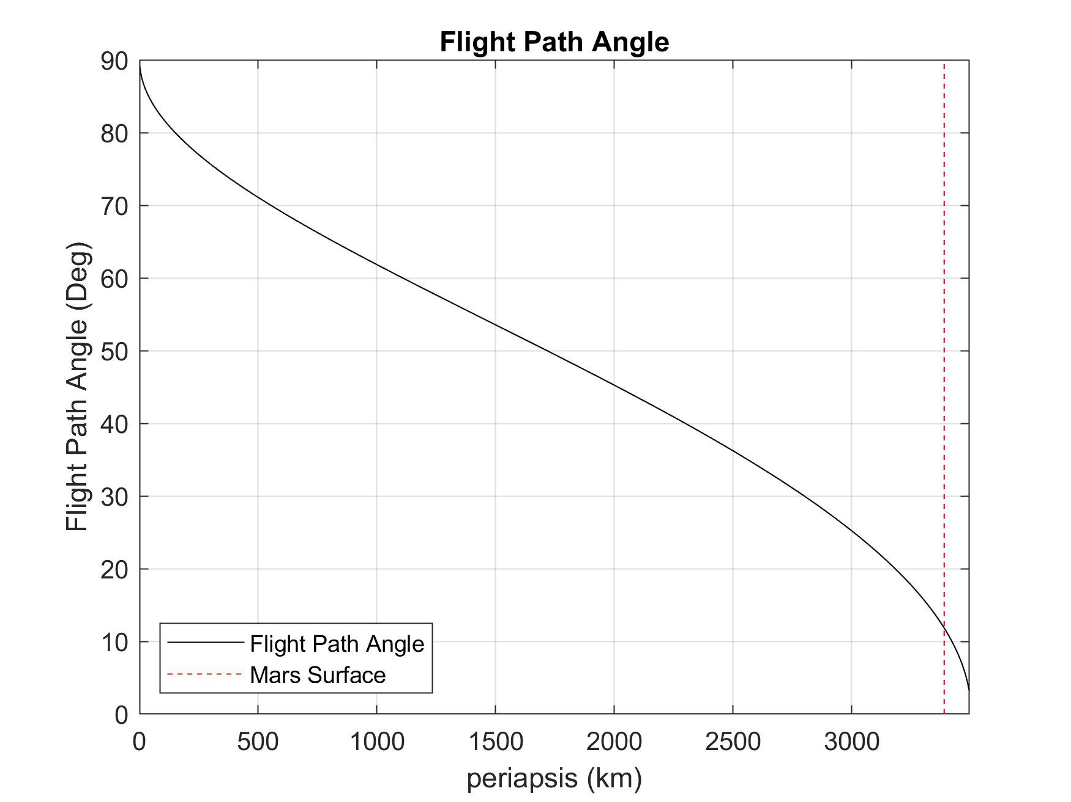
Astrodynamics - Mars Approach
V_{atm} at Mars will be constant for a fixed V∞ .
V_{atm} ≅ 5.94 km/s.
Flight path angle (ɣ) changes as a function of periapsis of approach trajectory. This change is shown in the figure to the right.
Periapsis must lay within Mars’ atmosphere, or the vehicle will “miss” the planet.
We chose a periapsis 24 km below the surface:
Ɣ = 13 degrees
JC

Slide 20
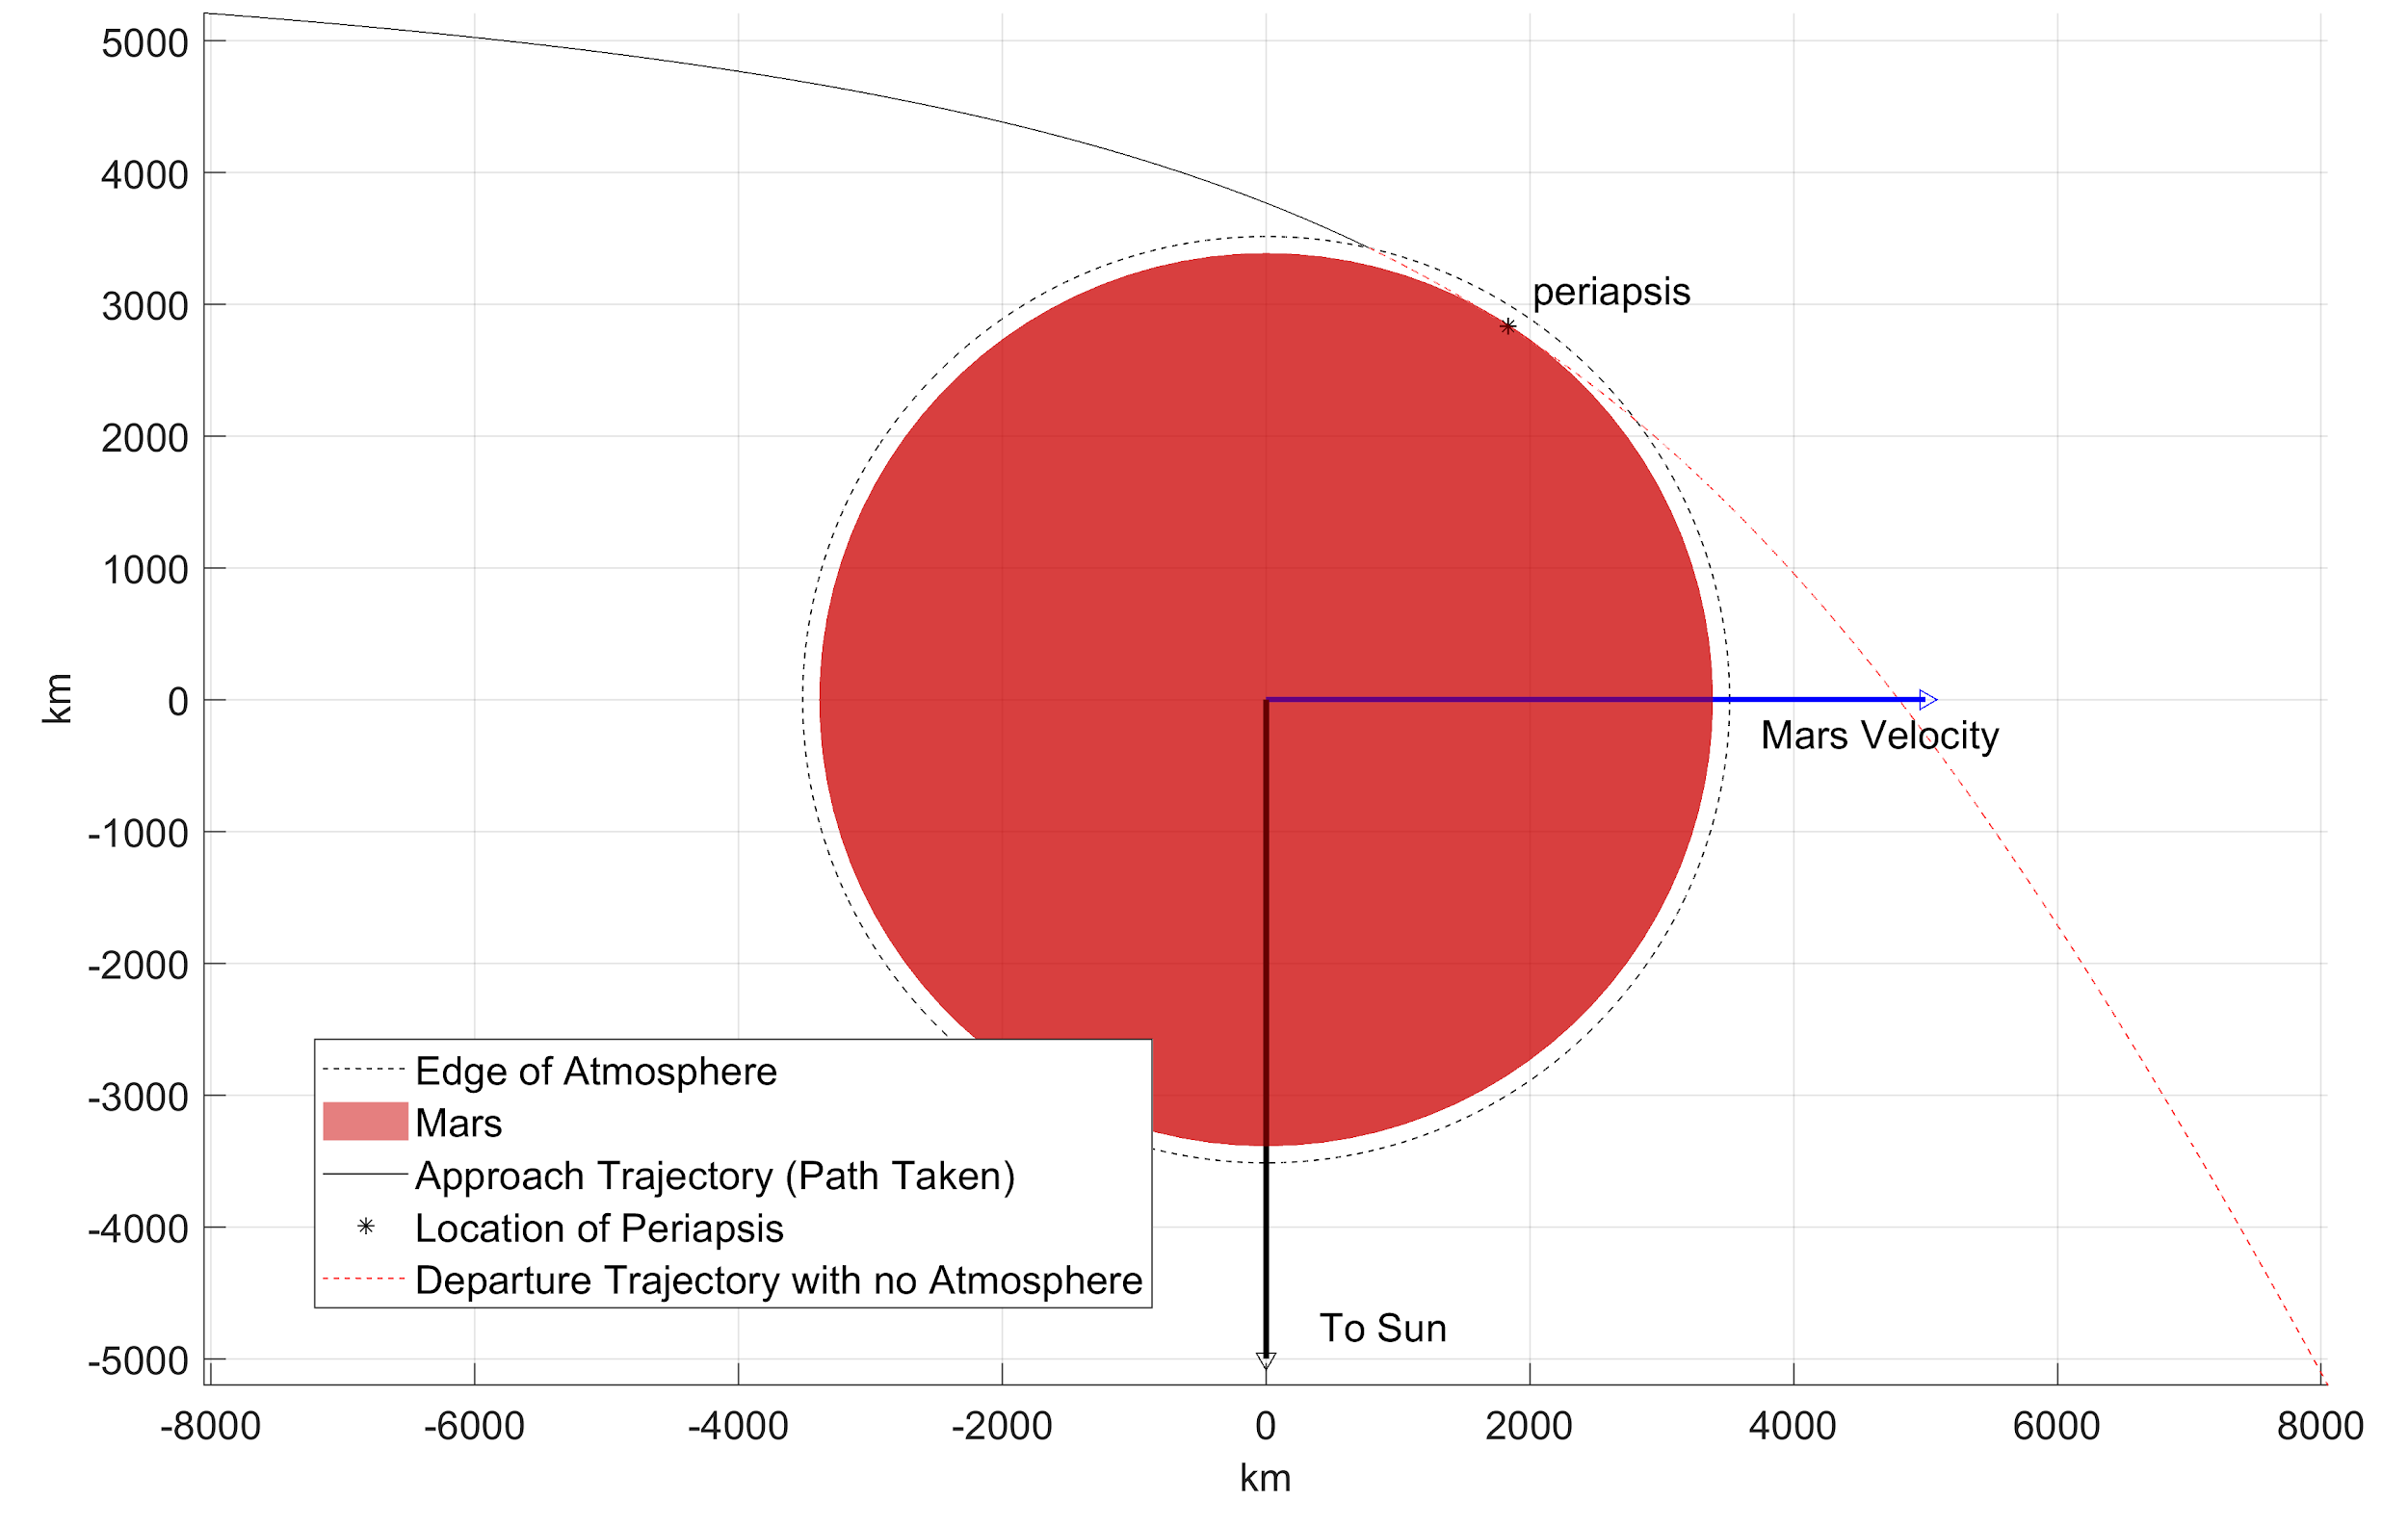
Astrodynamics - Mars Approach
The approach periapsis is changed by changing how large the aiming radius (Δ) is.
This is done through additional burns during transfer.
For the previously mentioned periapsis, AMERICA must achieve a Δ of 6,163 km at the edge of Mars’ SOI.
The figure shows AMERICA’s approach trajectory to Mars in black.
It is easy to visualize that if periapsis wasn’t within the atmosphere, AMERICA would perform a planetary fly-by.
Δ
JC

Slide 21
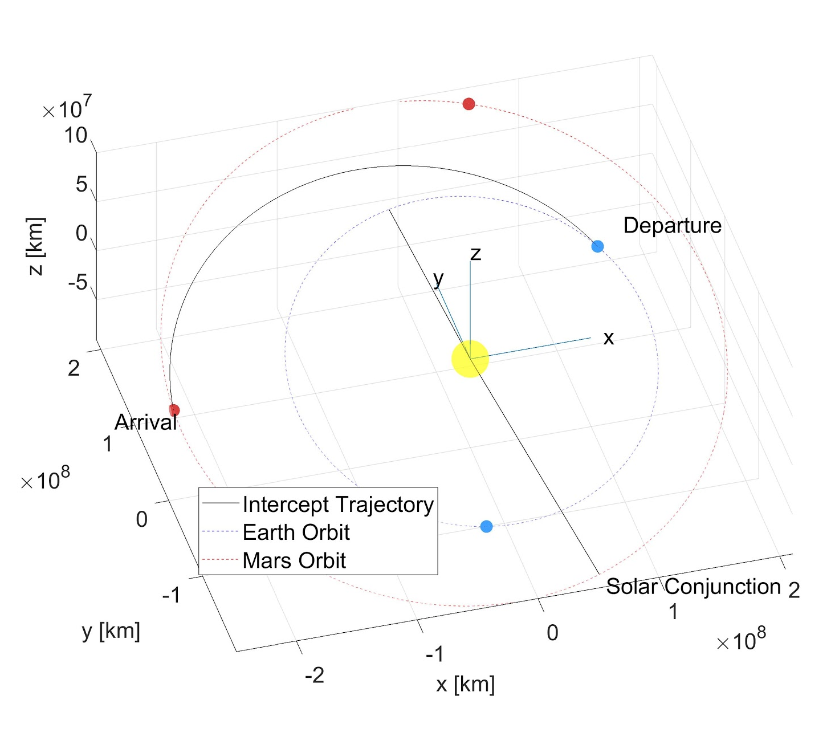
Astrodynamics - Solar Conjunction
The Mars’ solar conjunction is when Earth and Mars are on direct opposite sides of the Sun from each other.
Creates issues for sending commands to/from the vehicle on Mars.
It is important that critical events DO NOT occur during this time.
The first solar conjunction after AMERICA’s launch date occurs around January 2, 2026.
Occurs roughly 7 months after AMERICA lands on Mars.
AMERICA will be fully autonomous for a two week window centered around the date of the conjunction.
JC

Slide 22
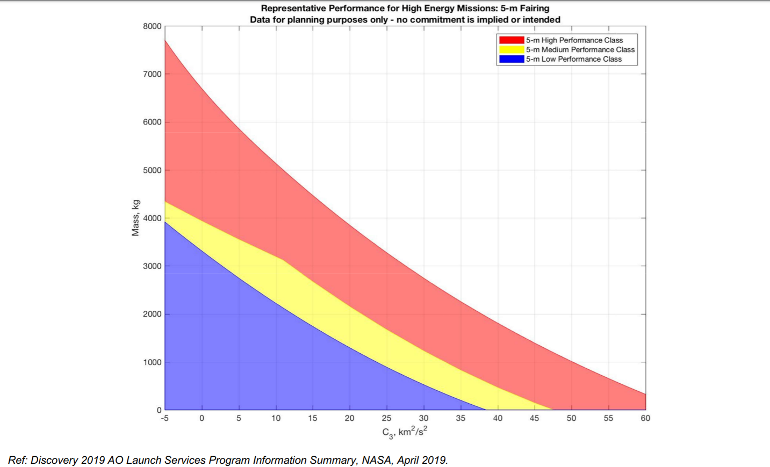
Astrodynamics - Launch Vehicle
Will use 5-m Low Performance Class.
C3 ≅ 20.5 km²/s²
Mass < 1000 kg
JC

Slide 23
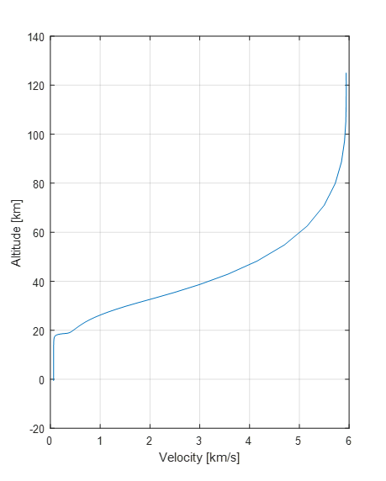
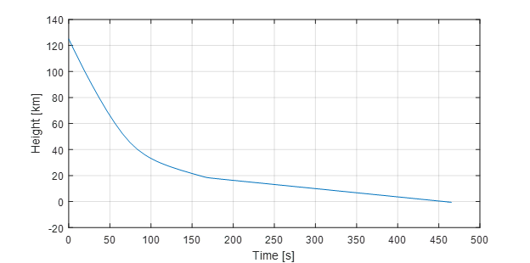
Entry, Descent, & Landing
Entry:
Velocity = 5.94 km/s
Flight path angle = 13°
Altitude = 125 km
Peak deceleration: 9.4 Earth g’s
Altitude of peak deceleration: 40 km
Terminal Velocity: 63.5 m/s
JM
Notes:
jasmina

Slide 24
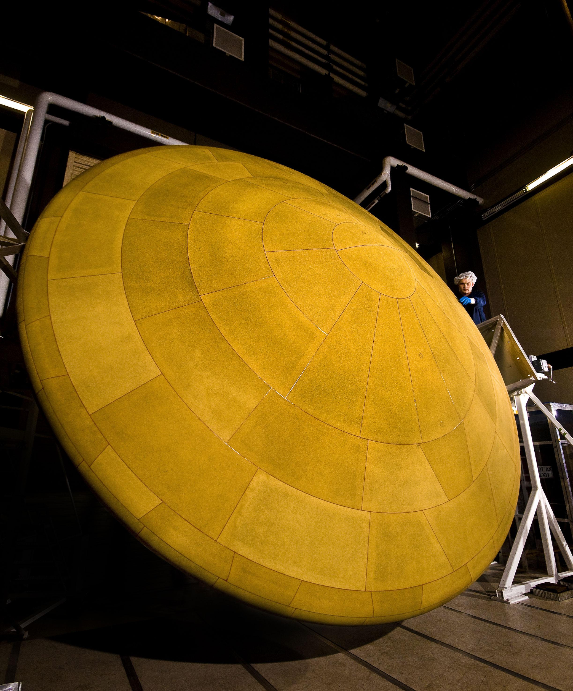
Thermal Protection System
Key Values:
Peak Heat Rate: 54.73 W/cm²
Total Integrated Heat Load: 4009.6 J/cm²
Heat Shield Mass: 63.5 kg
Material: Phenolic Impregnated Carbon Ablator (PICA)
Thickness: 3.61 cm
DS
Notes:
Daria

Slide 25
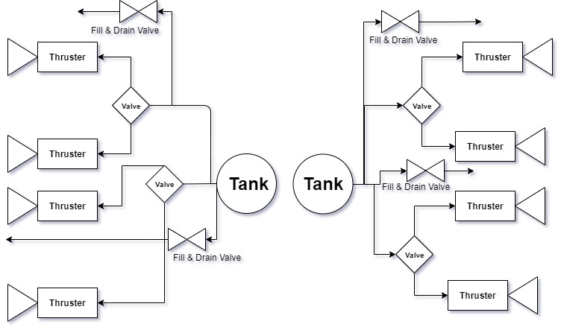
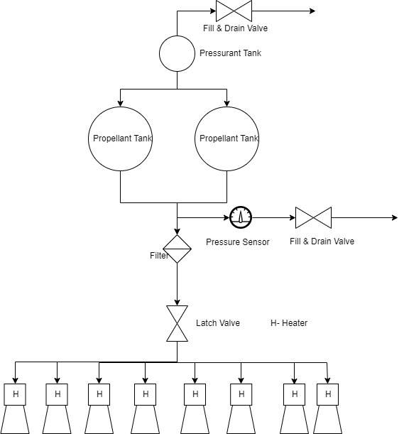
Propulsion Systems
Engines | Stage | Mass (kg) | Material | Power | Supply Voltage | ISP (seconds) | Nominal Thrust (N)
Moog 058-118 | Cruise | 0.023 | Stainless Steel, Nylon | 30 W @ 28 VDC | 28 VDC | 57 | 3.6
Aerojet Rocketdyne MR-104H | Entry | 23.54 | Stainless Steel, Nylon | 52 W (Valve) 8.1 W (Catalytic Bed) | 28 VDC | 237 | 510
VG

Slide 26
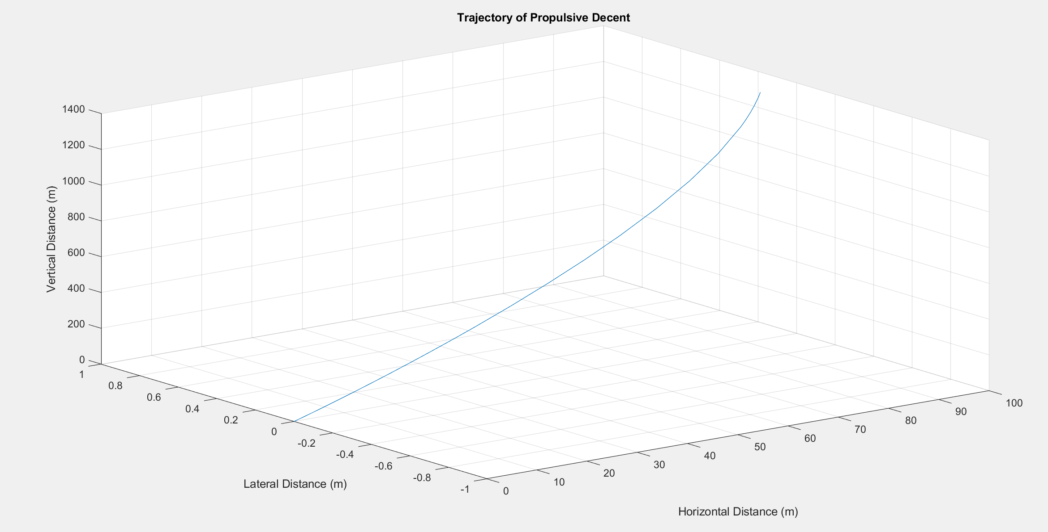
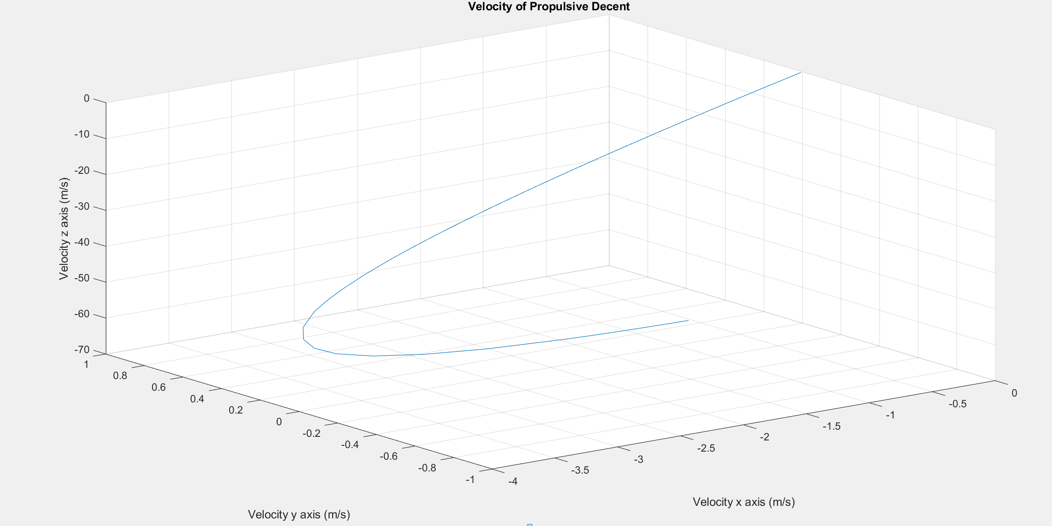
Propulsion Systems
VG

Slide 27
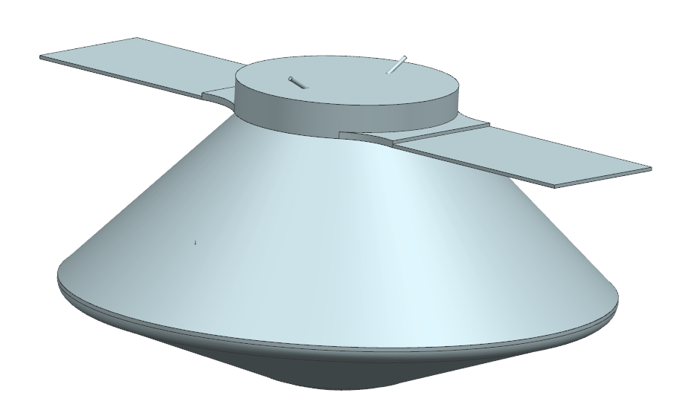
Mechanical design overview
Cruise internal volume 12.5 m³
2 Solar panels 1.6m² each
2 dipole and 2 horn antennas
KI

Slide 28
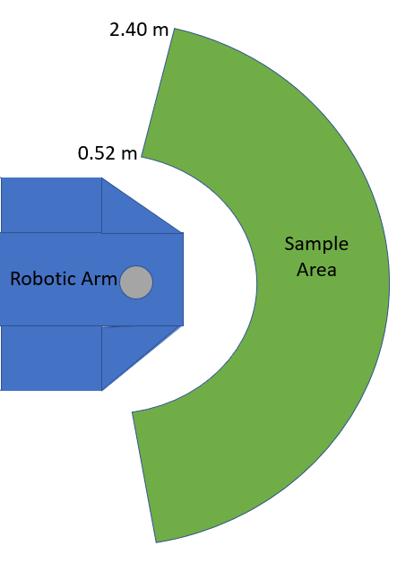
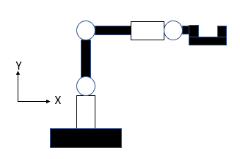
Robotic arm design
Sample area of 7.2 m²
5 degrees of freedom
2 lengths of 1.436 m
110 kg
KI

Slide 29
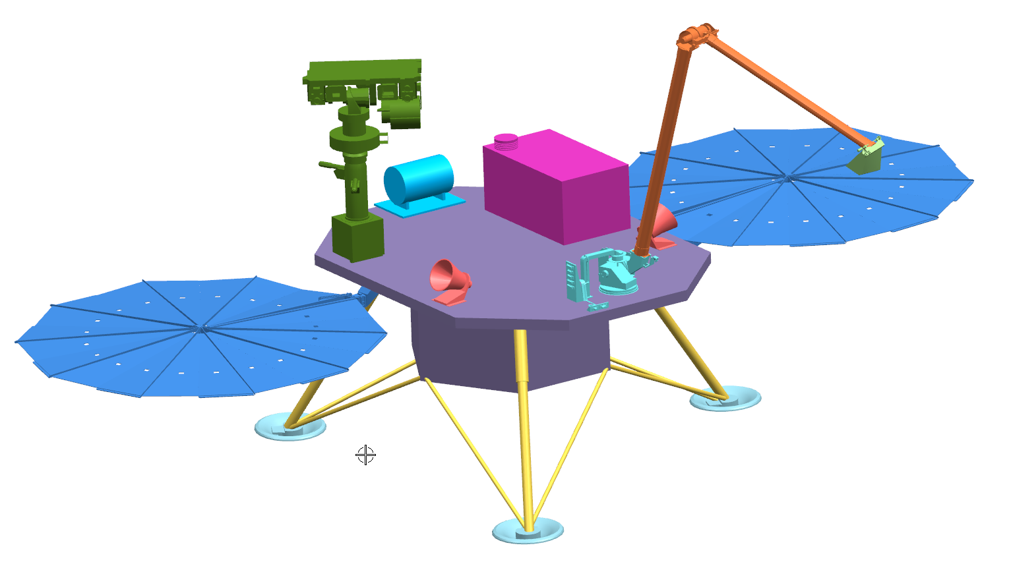
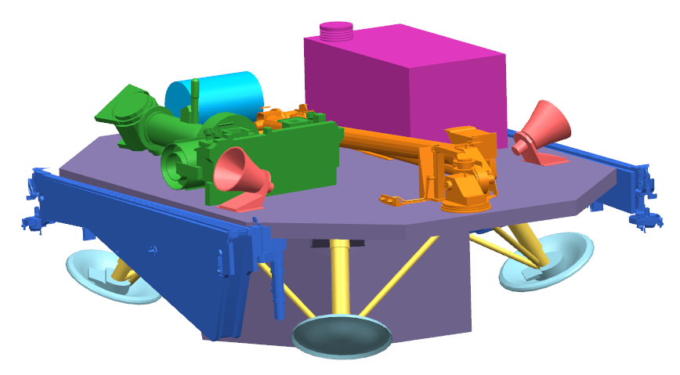
Mechanical Design - Lander
Deck Area: 1.43 m^2
Deck Height: 1 m
Lander Leg Material: Titanium
Aluminum 6061
SAM Unit
Robotic Arm
Mastcam-Z
Retractable Solar Panels
Stowed Configuration
Fully Deployed Configuration
SK

Slide 30
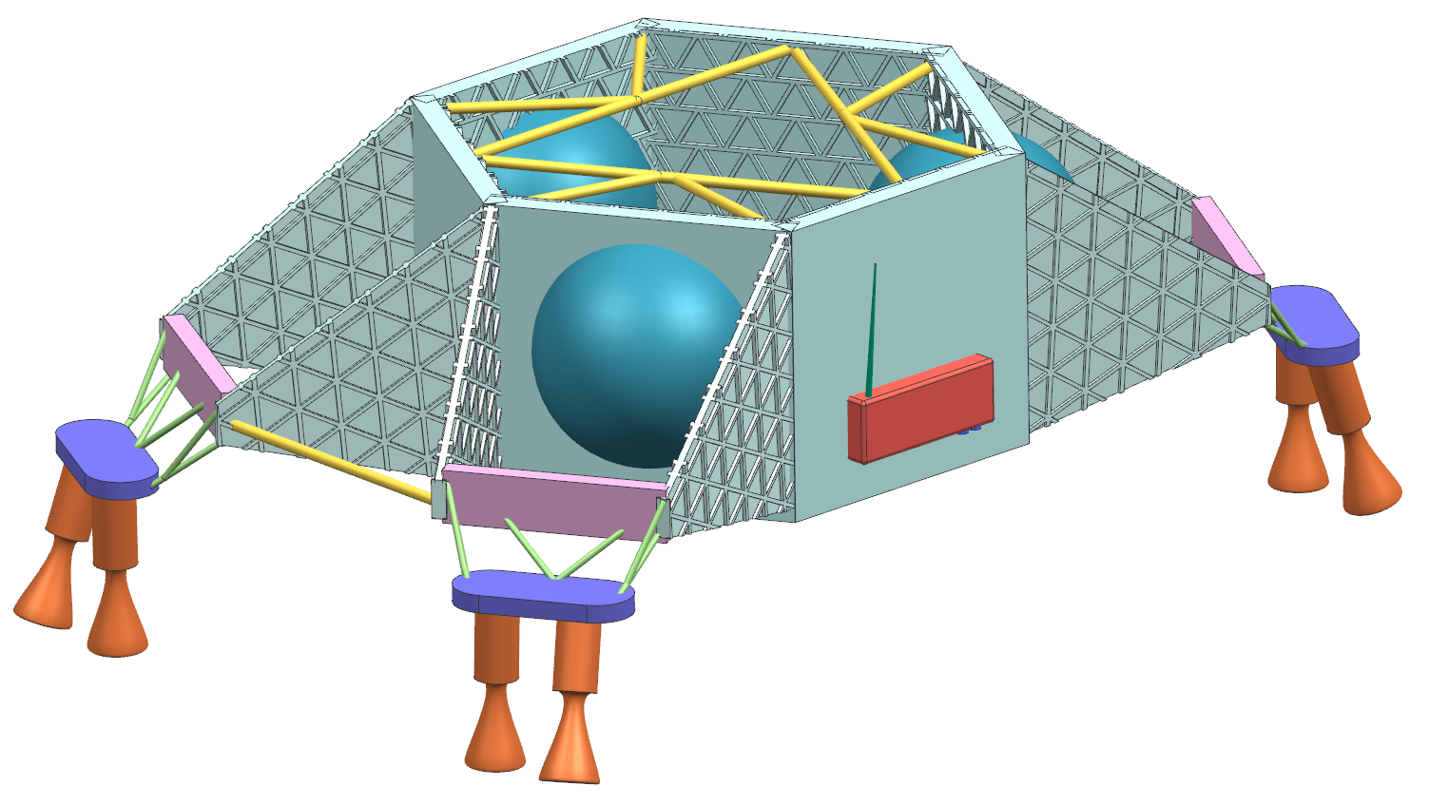
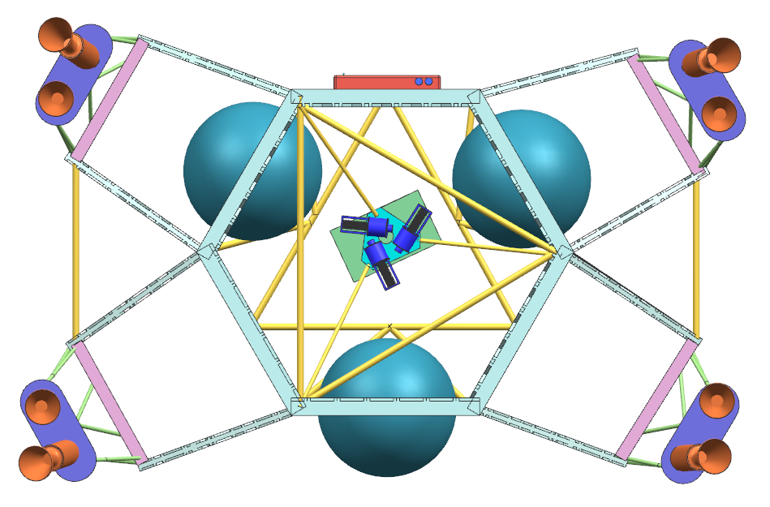
Mechanical Design - Skycrane
3 Spools with 9 m nylon tethers
Pyros to separate lander and cut tethers
4 down-angled thrusters, 4 side-angled thrusters for stability.
Avionics
Tether Spool
Battery & Umbilical Connection
Pyro Bracket
Isometric View
Bottom View
Triangle-wall structure for maximum strength and minimum weight.
1.65 m
SK

Slide 31
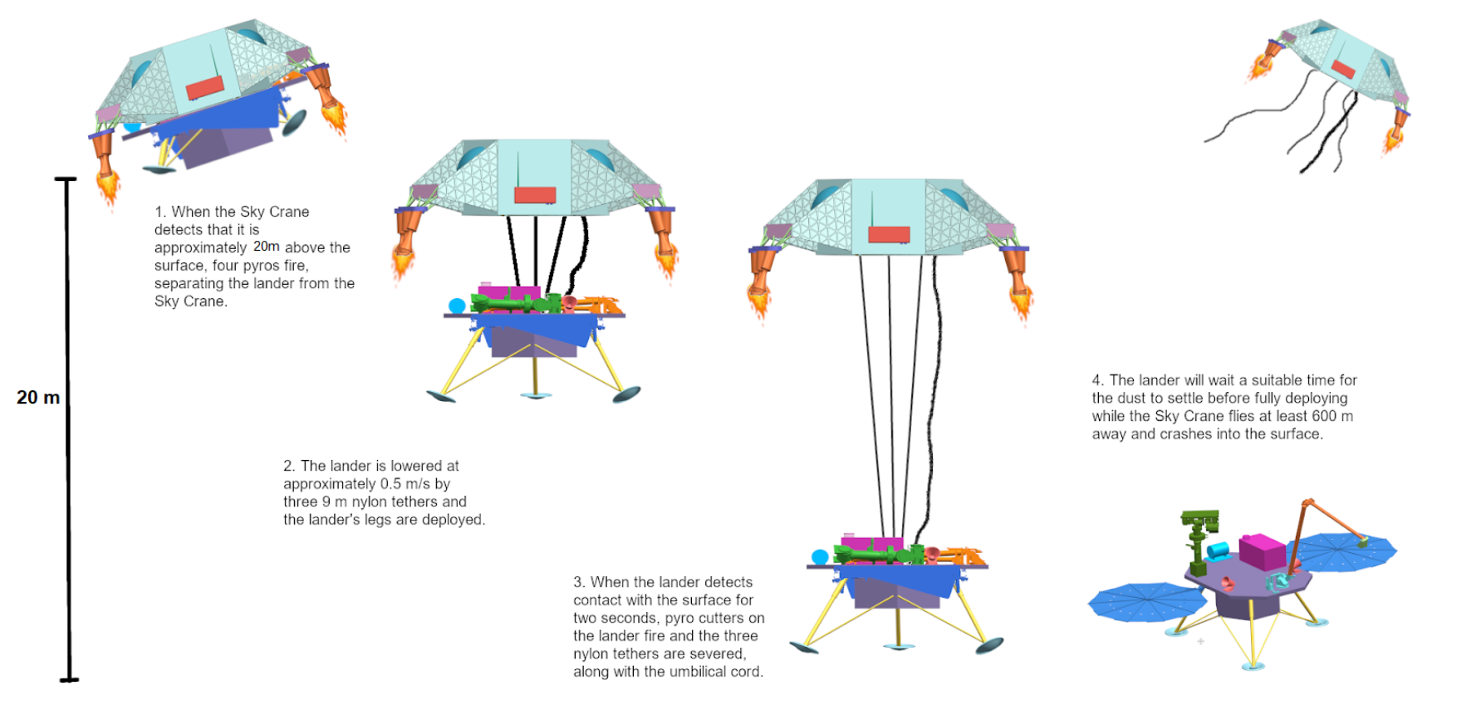
SK

Slide 32
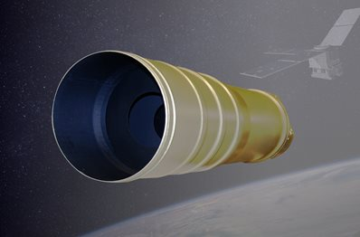
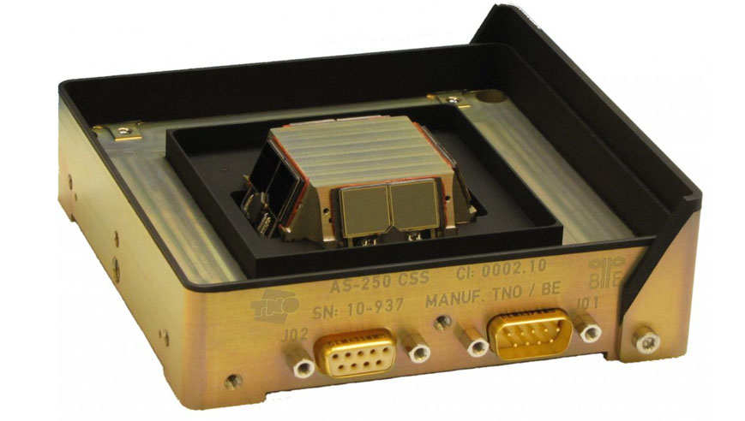
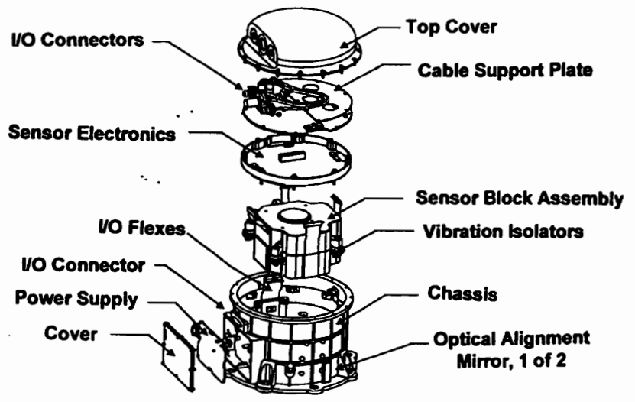
Attitude Determination and Control Systems
Navigational Devices
 | Name | Number | Total Mass (kg) | Power
Internal Measurement Unit | Honeywell MIMS IMU | 1 | 4.2 | 2.5 W | Rotation Rate | Gyro Bias
 |  |  |  | 28VDC | ±375°/sec | ≤ 0.005°/hr
Star Tracker | Ball CT2020 | 2 | 6 | 3.35 W | FOV | Accuracy
 |  |  |  | 5 VDC | 25° Circular | < 1 arcsec
Sun Tracker | Bradford Coarse Sun Sensor | 6 | 1.29 | 28 W | FOV | Accuracy
 |  |  |  | 5 VDC | ±90° Hemisphere | 1 degree
Honeywell IMU
Ball CT2020 Star Tracker
Bradford Coarse Sun Sensor
AC

Slide 33
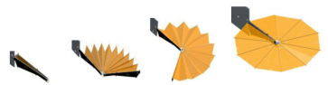
Power
Components
Solar Cells (Spectrolab)
Batteries (EaglePitcher)
Fully-regulated Direct Energy Transfer PMAD
Wiring
 | Technology | Mass/Area |  | Power Density | BOL Eff. | EOL Eff.
Solar Cell | XTE-SF 3J GalnP/GaAs/Ge | Cruise | Landed | 437 W/m² | 32.2% | 30.0%
 |  | 7.32 kg/m² | 2.51 kg/m²
 | Technology | Capacity | Specific Energy | Operating Temp
Solar Cell | Li-Ion | 30 Ah | 141 Wh/kg | -20 to 60ºC
MD, VP
Notes:
Vince
Talk about dust mitigation and orientation change

Slide 34
Power Budget
Power Modes
Cruise: Propulsion,Communication, ADCS
Landed: Science, Communication, Rest
Power Breakdown to Level Three Elements
Element | Peak Power (W) | Standby Power (W)
1.0 Payload
1.1 Science Instrumentation
1.1.1 SAM | 375 | 0
1.1.2 Robotic Arm | 20 | 5
1.1.3 EMS | 0.015 | 0
1.1.4 TECP | 6.66 | 0.8
1.1.5 Mastcam-Z (2) | 23.6 | 8
1.1.6 Microscopic Imager | 4.3 | 2.5
1.1.7 Chemistry Camera (LIBS & RMI) | 64.7 | 11.8
1.1.8 Modified Lunar Dust Experiment (MLDEX) | 6.11 | 3.8
2.0 Spacecraft Bus
2.1 Propulsion
2.1.1 Cold Gas Thruster (2) | 60 | 0
2.2 ADCS
2.2.1 CT2020 Star Tracker | 28 | 0
2.2.2 Fine Sun Sensor | 28 | 0
2.2.3 Honeywell MIMS | 28 | 0
2.3 Communications
2.3.1 X-band Amplifier | 65.5 | 0
2.3.2 Small Deep Space Transponder (X-band) | 15.8 | 0
2.3.3 Electra Lite UHF Transponder | 20.6 | 0
2.4 Power
2.4.1 PMAD | 111.46 | 0
2.4.2 Wiring | 43.47 | 0
2.6 Thermal Control System
2.6.1 Electric Heaters | 66 | 0
2.7 C&DH
2.7.1 Rad 5545 SBC | 35 | 5
MD, VP
Notes:
Vince

Slide 35
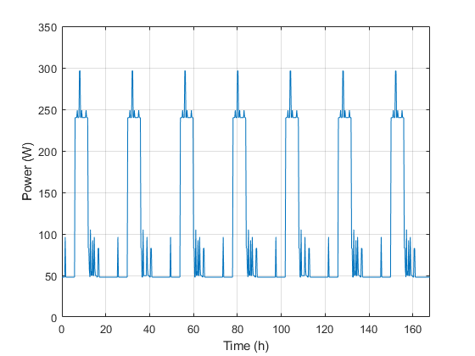
Power Profile
Power Consumption
7 sol cycle
Different functions of the equipment used on each day
Highest power consumption is during SAM instrumentation usage
MD, VP
Notes:
Vince

Slide 36
Thermal Control System
Thermal Environment
Absorptivity = 0.23, Emissivity = 0.85
44 degrees Celsius High
-62 degrees Celsius Low
Passive TCS
Heat Rejection System
Warm Electronics Box
Active TCS
Electrical heaters
Louvers
Heat Switch
LHP Pumps
Primary Components | Survivability Temperature range (Degrees Celsius)
Batteries | -20 to 60
C&DH | -25 to 75
Computers | -55 to 70
IMU | -30 to 70
TXCO | -40 to 85
Notes:
Vince

Slide 37
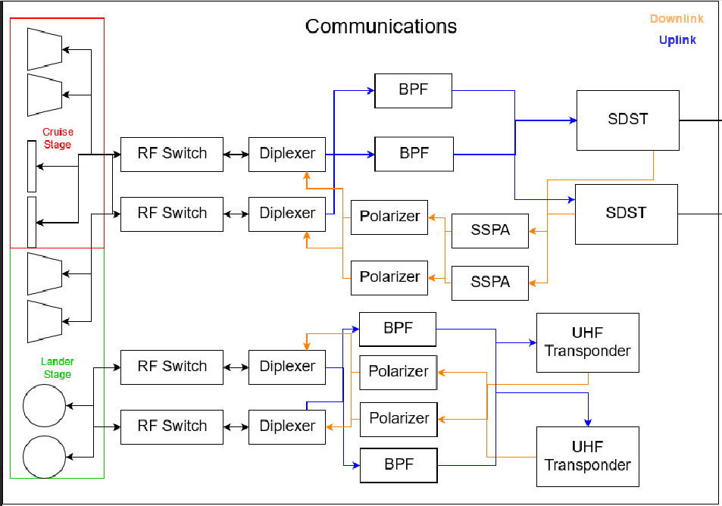
Communication Hardware Overview
X Band System
Command Uplink
Tracking
UHF Band System
Science Data
Engineering Data
Command Uplink
To Command and Data Handling
SB
Notes:
Steven

Slide 38
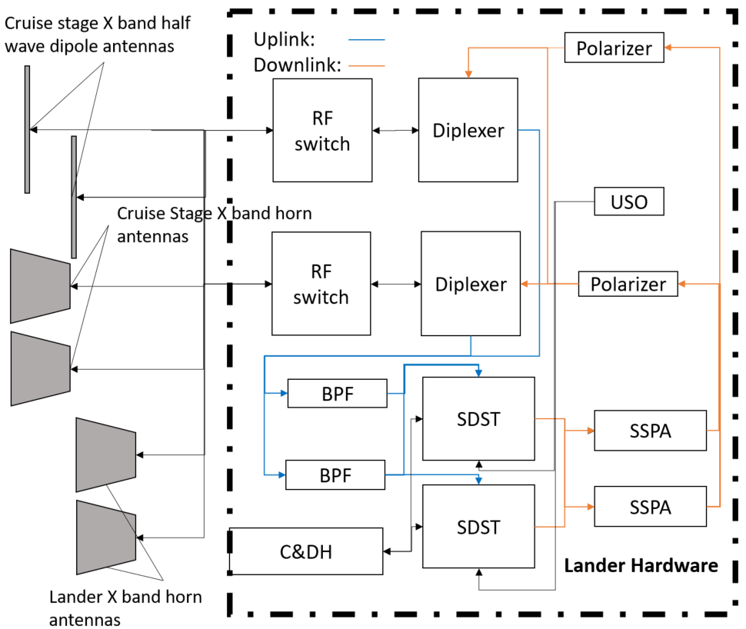
X Band Hardware
General Dynamics Small Deep Space Transponder
Cruise Stage
Dipole Low Gain Antennas (LGAs)
Horn Medium Gain Antennas (MGAs)
Lander Stage
Horn MGAs
Direct DSN Link
34 m BWG
34 m HEF
70 m (critical events)
Tracking modes
Two-Way Doppler
Delta-DOR
SB
Notes:
Steven

Slide 39
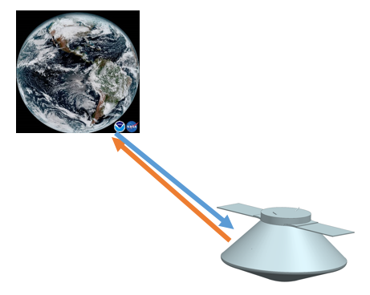
X Band Cruise Stage Link Characteristics
Characteristic | Value
Uplink Frequency | 7.145-7.190 GHz [19]
Downlink Frequency | 8.400 - 8.450 GHz [19]
Worst Case Uplink Rate (LGA to 34m) | 32 bps
Worst Case Downlink Rate (LGA to 34m) | Single Tracking Tone
SB
Notes:
Steven

Slide 40

X Band Lander Stage Link Characteristics
Characteristic | Value
Uplink Frequency | 7.145-7.190 GHz [19]
Downlink Frequency | 8.400 - 8.450 GHz [19]
Worst Case Uplink Rate (MGA to 34m) | 512 bps
Worst Case Downlink Rate (MGA to 34m) | Single Tracking Tone
SB
Notes:
Steven

Slide 41

UHF Band Hardware
Mars Relay Network Link
MRO
TGO
Electra-Lite UHF Transponder
Lander Stage
Medium Gain UHF Helical Antennas
SB
Notes:
Steven

Slide 42
UHF Band Lander Link Characteristics
Characteristic | Value
Uplink Frequency | 435-450 MHz [20]
Downlink Frequency | 390-405 MHz [20]
Worst Case Uplink Rate (to MRO) | 128 kbps
Worst Case Downlink Rate (from MRO) | 128 kbps
SB
Notes:
Steven

Slide 43


Relay Network Access Intervals
Orbits for Mars Relay Network - taken 01 Jan 2018 (TGO estimated)
Access intervals with downlink data transfer capability over one sol
WP
Notes:
Steven

Slide 44


Relay Network Access Intervals
Gbits data per sol
Gbits data per sol
Expected data uplink volume per sol over a typical martian year
~22.75 GB/week downlink or ~15.7 GB/week uplink capability with entire relay network
Still need to share with other landers
Only 300-400 MB per week required for science data downlink...
Expected data downlink volume per sol over a typical martian year
WP
Notes:
Steve

Slide 45
Relay Orbiter Downselect
MRO
Circular orbit
Medium downlink rate
Supports uplink
Odyssey
Circular orbit
Medium downlink rate
Supports uplink
MAVEN
Elliptical orbit causes problems
Low downlink rate
TGO
Circular orbit
High downlink rate
Does not support uplink
MRO & TGO
High downlink rate
Differently inclined circular orbits
Uplink capable
Power efficient
Cost effective
584 MB DL / 2.52MB UL+540 MB DL (weekly)
WP, SB
Notes:
Steven

Slide 46
Science Data Collection Modes
3 regular science operation modes
Mode 1 (3x/wk)
One SAM atmospheric analysis
Continuous EMS
5 TECP measurements
3 ChemCam targets
One image per MastCam/Microscopic imager
MLDEX
Mode 2 (2x/wk)
One SAM atmospheric analysis
Continuous EMS
5 TECP measurements
3 ChemCam targets
Mode 3 (2x/wk)
One solid sample SAM analysis
Continuous EMS
5 TECP measurements
3 ChemCam Targets
One image per MastCam/Microscopic imager
Dust Storm Mode
2 MLDEX measurements
Expected weekly data collection:
240 MB (75 kB dust storm)
Expected weekly power consumption:
7855 W-hr (0.8 W-hr dust storm)
DS, WP, SB
Notes:
Steven

Slide 47
Data Budget Between Communications Intervals
240 MB expected science data/week
584 MB max downlink to MRO & TGO/week
In a given week, half of the downlink opportunities can be missed (offers flexibility)
In case of prolonged communications failure: onboard memory
Onboard memory:
2x 4 GB SDRAM, 2x 1 GB TMR Flash
SDRAM (volatile) primarily used for science data, Flash (non-volatile) primarily used for commands/mission critical information
@ 240 MB/week, takes 16 weeks for memory to fill (worst case)
WP
Notes:
Steven

Slide 48

System Interconnect Diagram
WP, SB
Notes:
Steve

Slide 49
Risk
Rank | Approach | Risk Title
1 | Mitigate | Lander does not observe sporadic release of methane in the atmosphere
2 | Mitigate | Lander battery is depleted during a dust storm
3 | Mitigate / Watch | Touchdown on hard/rocky/uneven surface
4 | Mitigate | Propulsion disrupts landing area during descent
5 | Mitigate | Solar panels covered in dust from surroundings
6 | Mitigate / Watch | Robotic arm fails
 |  | AMERICA Risk Matrix
 | 5
 | 4 |  |  |  | [1]
 | 3
 | 2 |  |  | [3] , [5] | [2] | [4] , [6]
 | 1
 |  | 1 | 2 | 3 | 4 | 5
 |  | Consequence
Probability
DS
Notes:
Daria

Slide 50
Risk Mitigation
Rank | Risk Title | Approach
1 | Lander does not observe sporadic release of methane in the atmosphere | Mitigate - measure surface and subsurface methane
2 | Lander battery is depleted during a dust storm | Mitigate - reduced power mode during storms
3 | Touchdown on hard/rocky/uneven surface | Mitigate - careful selection of landing sight / Watch
4 | Propulsion disrupts landing area during descent | Mitigate - inclusion of skycrane
5 | Solar panels covered in dust from surroundings | Mitigate - increased solar panel size & orientation change
6 | Robotic arm fails | Mitigate - reduced degrees of freedom / Watch
DS
Notes:
Daria

Slide 51

Cost
VG

Slide 52

Schedule
WP

Slide 53
JC, KI, SB,VG, VP, WP
Notes:
This implementation will allow the AMERICA mission to answer the primary science questions about the origins of methane variations on Mars and the formation of dust storms

Slide 54
References
[1] Webster, C., Mahaffy, P, Sushil, A., Moores, J., Flesch, G., Malespin, C., McKay, C., Martinez, G., Smith, C., “Background levels of Methane in Mars’ atmosphere show strong seasonal variations,” Science, 8 June 2018, pp. 1093-1096.
[2] Giuranna, M., Viscardy, S., Daerden, F., Neary, L., Etiope, G., Oehler, D., Formisano, V., Aronica, A., Wolkenberg, P., Aoki, S., Cardesin-Moinelo, A., Parra, J., Merritt, D., Amoroso, M., “Independent Confirmation of a Methane Spike on Mars and a Source Region East of Gale Crater. Nature Geoscience, Vol 12, May 2019, pp. 326–332.
[3] Summers, M.E., Lieb, B.J., Chapman, E., and Yung, Y.L. “Atmospheric biomarkers of subsurface life on Mars,” Geophys Res Lett 29, 2002, doi:10.1029/2002GL015377.
[4] Deep Carbon Observatory, “Rewriting the textbook on fossil fuels: New technologies help unravel nature's methane recipes,” Physics.org, April 2019
[5] Hu R., Bloom, A. A., Gao, P., Miller, C. E., Yung, Y. L., “Hypotheses for Near-Surface Exchange of Methane on Mars,” Astrobiology, Vol 16, No. 7, 2016, pp. 539-550. DOI: 10.1089/ast.2015.1410
[6] Image URL: http://www.oneworldoneocean.com/blog/entry/scientists_unravel_the_ocean_methane_mystery
[7] Miglovets, M., Schreiber, P., Schneider, J., Lukasheva, M., “Long-term Dynamics of Methane Emission in Mesooligotrophic Peatland,” Ecosystem of a Mesooligotrophic Peatland in Northwestern Russia, September 2016.
[8] “Tracking Methane Emissions from Arctic Tundra,” GlobalChange.Gov, 1 Dec 2016.
[9] Pondrelli, M., Rossi, A. Ori, G., Gasselt, S., Praeg, D., Ceramicola, S., “Mud volcanoes in the geologic record of Mars: The case of Firsoff crater,” Earth and Planetary Science Letters, 15 April 2011, pp. 511-519.
[10] Image URL: https://www.nature.com/articles/d41586-019-00575-2
[11] Image URL: http://macrocosm-magbook.blogspot.com/2007/10/martian-dust-devils-caught-by-spirit.html

Slide 55
References
[12] Sheppard, J. C., Westberg, H., Hopper, J. F., Ganesan, K., and Zimmerman, P., “Inventory of global methane sources and their production rates,” Journal of Geophysical Research, vol. 87, 1982, p. 1305.
[13] Ojha, L., Lewis, K., Karunatillake, S., Schmidt, M., “The Medusae Fossae Formation as the single largest source of dust on Mars,” Nature Communications, No. 2867 (2018), 2018, pp. 1 - 7.
[14] Mahaffy, P.R., Webster, C.R., Cabane, M., Conrad, P.G., Coll, P., Atreya, S.K., ..., Mumm, E. “The Sample Analysis at Mars Investigation and Instrument Suite” Space Science Reviews (2012) 170: 401. https://doi.org/10.1007/s11214-012-9879-z
[15] Wiens, R.C., Maurice, S., Barraclough, B., Saccoccio, M., Barkley, W. C., …, Wong-Swanson, B. “The ChemCam Instrument Suite on the Mars Science Laboratory (MSL) Rover: Body Unit and Combined System Tests” Space Science Reviews (2012) 170: 167. https://doi.org/10.1007/s11214-012-9902-4
[16] Zent, A. P., M. H. Hecht, D. R. Cobos, G. S. Campbell, C. S. Campbell, G. Cardell, M. C. Foote, S. E. Wood, and M. Mehta (2009), “Thermal and Electrical Conductivity Probe (TECP) for Phoenix,” J. Geophys. Res.,114, E00A27,
doi: 10.1029/2007JE003052.
[17] Oehler, D. Z., and Etiope, G., “Methane Seepage on Mars: Where to Look and Why,” Astrobiology, Vol. 17, No. 12, 2017, pp. 1233 - 1264.
[18] Formisano, V., Atreya, S. Encrenaz, T., Ignatiev, N., and Giuranna, M., “Detection of Methane in the Atmosphere of Mars,” Science, Vol. 306, Issue 5702, 2004, pp. 1758 - 1761. doi: 10.11226/science.1101732
[19] Imbriale, W. A., “Technology Drivers,” Spaceborne Antennas for Planetary Exploration, Jet Propulsion Laboratory, January 2006, pp. 3-6.
[20] “Electra-Lite Mars Proximity-Link Communications and Navigation Payload Description,” Jet Propulsion Laboratory, April 2019

